Slide 1
Application of Image Processing

Slide 2
Applications of Digital Image Processing
Some of the major fields in which digital image processing is widely used are mentioned below
Medical field
Remote sensing
Communication
Computer/ Machine/Robot vision
Color processing
Video processing
Microscopic Imaging
Agriculture
Industrial and Manufacturing Applications

Slide 3
Image sharpening and restoration
Image sharpening and restoration refers here to process images that have been captured from the modern camera to make them a better image or to manipulate those images in way to achieve desired result.
It refers to do what Photoshop usually does.
This includes Zooming, blurring , sharpening , gray scale to color conversion, detecting edges and vice versa , Image retrieval and Image recognition

Slide 4
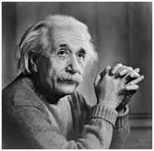
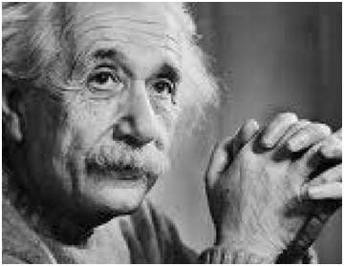
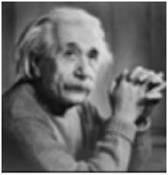
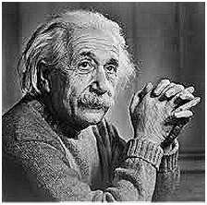
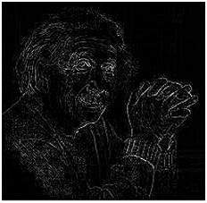
The common examples are:
The original image The zoomed image Blurr image
          Sharp image Edges

Slide 5
Medical field
The common applications of DIP in the field of medical is
Gamma ray imaging
PET scan
X Ray Imaging
Medical CT
UV imaging

Slide 6
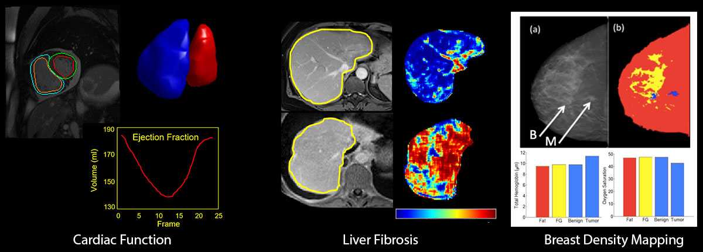

Slide 7
UV imaging/Remote sensing
In the field of remote sensing , the area of the earth is scanned by a satellite or from a very high ground and then it is analyzed to obtain information about it.
One particular application of digital image processing in the field of remote sensing is to detect infrastructure damages caused by an earthquake.

Slide 8
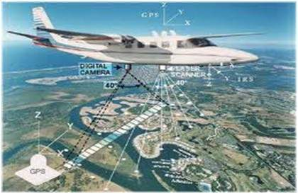
An Example of Remote sensing

Slide 9
Machine/Robot vision
Apart form the many challenges that a robot face today, one of the biggest challenge still is to increase the vision of the robot.
Make robot able to see things, identify them, identify the hurdles e.t.c.
Much work has been contributed by this field and a complete other field of computer vision has been introduced to work on it.

Slide 10
Hurdle detection
Hurdle detection is one of the common task that has been done through image processing, by identifying different type of objects in the image and then calculating the distance between robot and hurdles.

Slide 11
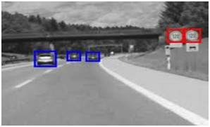
Example of Hurdle detection

Slide 12
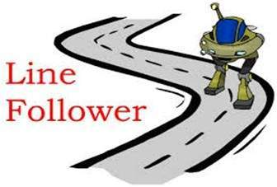
Line follower robot
Most of the robots today work by following the line and thus are called line follower robots. This help a robot to move on its path and perform some tasks. This has also been achieved through image processing.

Slide 13
Video processing
A video is nothing but just the very fast movement of pictures.
The quality of the video depends on the number of frames/pictures per minute and the quality of each frame being used.
Video processing involves noise reduction , detail enhancement, motion detection, frame rate conversion, aspect ratio conversion , color space conversion e.t.c.

Slide 14
Applications in Weed detection:
Weeds were the plants growing in wrong place in farm which compete with crop for water, light, nutrients and space, causing reduction in yield and effective use of machinery.
Weed control was important from agriculture point of view, so many researchers developed various methods based on image processing.
Weed detection techniques used algorithms based on edge detection, color detection, classification based on wavelets, fuzzy etc.

Slide 15
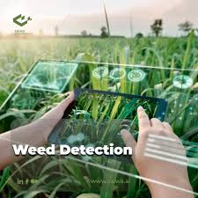

Slide 16
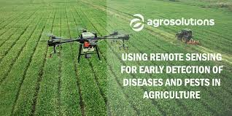

Slide 17
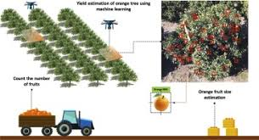
Crop yield estimation

Slide 18
Applications in fruit / food grading:
Need of accurate grading, sorting of fruits and foods or agriculture products arises because of increased expectations in quality food and safety standards.
It causes increased processing and labor work. Computer vision and image. processing were non destructive, accurate and reliable methods to achieve target of grading.

Slide 19
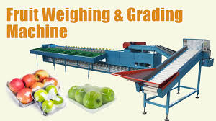

Slide 20
Pattern recognition
Pattern recognition involves study from image processing and from various other fields that includes machine learning ( a branch of artificial intelligence).
In pattern recognition , image processing is used for identifying the objects in an images and then machine learning is used to train the system for the change in pattern.
Pattern recognition is used in computer aided diagnosis , recognition of handwriting , recognition of images e.t.c

Slide 21
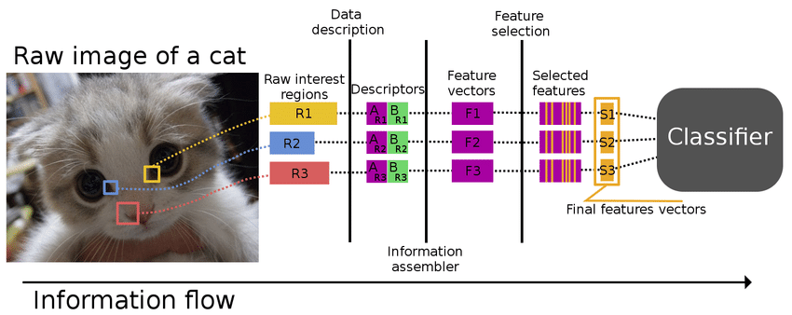

Slide 22
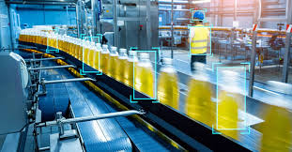
Industrial and Manufacturing Applications

