Slide 1
UNIT-V
FPGA Design
&
Introduction to Advanced Technologies
By
Mr. V. Naveen Raja, M. Tech
Associate Professor, ECE Dept.
Narasaraopeta Engineering College

Slide 2
CONTENTS:
PART-A: FPGA Design
VLSI Design flow
FPGA design flow
Basic FPGA architecture
FPGA Technologies
PART-B: INTRODUCTION TO ADVANCED TECHNOLOGIES:
Giga-scale dilemma
Short channel effects
High–k
Metal Gate Technology
FinFET
TFET

Slide 3
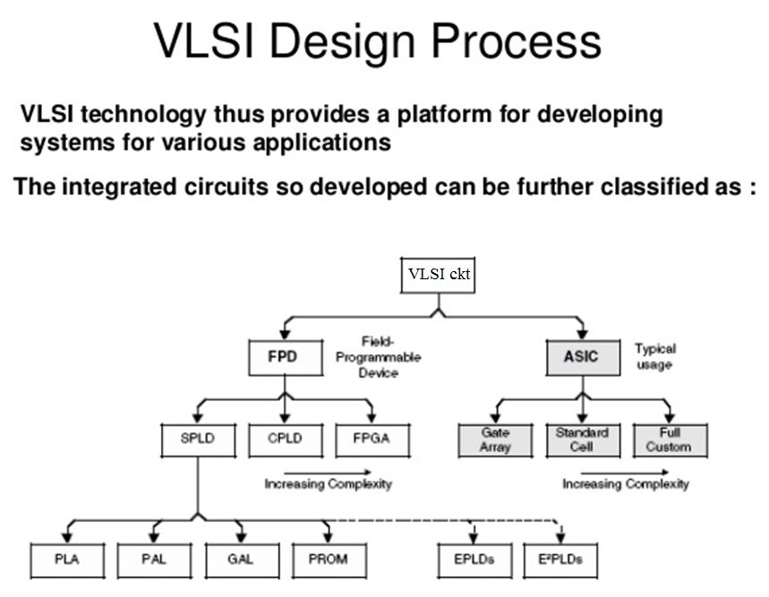

Slide 4
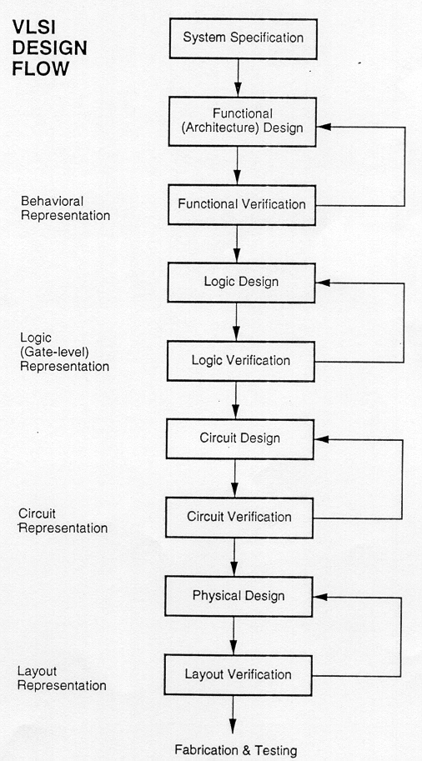
VLSI Design flow

Slide 5
FPGA Design flow
FPGA provide the next generation in the programmable logic devices.
The word Field in the name refers to the ability of the gate arrays to be programmed for a specific function by the user instead of by the manufacturer of the device.
The word Array is used to indicate a series of columns and rows of gates that can be programmed by the end user.

Slide 6
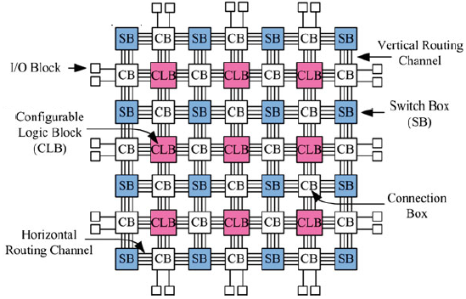
FPGA Architecture
FPGA contains a two dimensional arrays of logic blocks and interconnections b/w logic blocks.
Both the logic blocks and interconnects are programmable.
Logic blocks are programmed to implement a desired function and the interconnects are programmed using the switch boxes to connect the logic blocks.

Slide 7
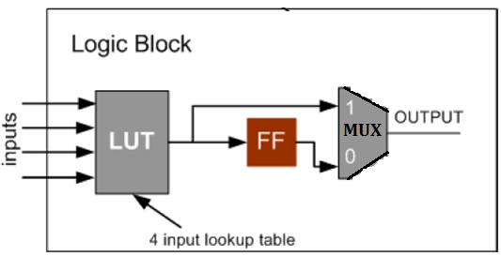
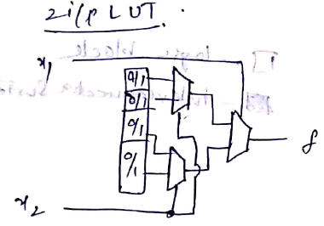
CLB
The logic block consists of one Look Up Table (LUT) and one FlipFlop.
An LUT is used to implement number of different functionality. The input lines to the logic block go into the LUT and enable it.
The output of the LUT gives the result of the logic function that it implements and the output of logic block is registered or unregistered output from the LUT.
SRAM is used to implement a LUT.

Slide 8
Interconnects
A wire segment can be described as two end points of an interconnect with no programmable switch between them.
A sequence of one or more wire segments in an FPGA can be termed as a track.
Typically an FPGA has logic blocks, interconnects and switch blocks (Input / Output blocks).
Switch blocks lie in the periphery of logic blocks and interconnect.
Wire segments are connected to logic blocks through switch blocks.
Depending on the required design, one logic block is connected to another and so on.

Slide 9
xbar Switches
Connection Box
Used to connect adjacent switch box, CLB with vertical and horizontal wires.
I/O Pads
These input and Output pads are used for signal conditioning at chip input and output lines.
Used to connect vertical and horizontal wires.
When a wire enters into a switch box, there are three programmable switches that allow it to connect to three other wires in adjacent wires.

Slide 10
FPGA Advantages
Design cycle is significantly reduced. A user can program an FPGA design in a few minutes or seconds rather than weeks or months required for mask programmed parts.
High gate density i.e it offers large gate counts.
No custom masks tooling is required (Low cost).
Low risk and highly flexible.
Reprogram ability for some FPGAs (design can be altered easily).
Suitable for prototyping.
Parallelism
FPGA Limitations
Speed is comparatively less.
The circuit delay depends on the performance of the design implementation tools.
The mapping of the logic design into FPGA architecture requires sophisticated design implementation (CAD) tools than PLDs.

Slide 11
FPGA Technologies
Basically there are three programming technologies are there for FPGA.
Static RAM
Antifuse
Flash
SRAM-based FPGAs
They use a standard fabrication process that chip fabrication plants are always optimizing for better performance.
Since the SRAMs are reprogrammable, the FPGAs can be reprogrammed any number of times, even while they are in the system, just like writing to a normal SRAM.
SRAM devices can easily use the internal SRAMs as small memories in the design.
The disadvantages of SRAM-based FPGAs are that they are volatile, which means a power glitch could potentially corrupt the contents of the device.
SRAM devices have large routing delays and are slower than other technologies.

Slide 12
FPGA Technologies
Basically there are three programming technologies are there for FPGA.
Static RAM
Antifuse
Flash
Antifuse FPGAs
These are non-volatile and the delays due to routing are very small, so they tend to be faster.
Antifuse FPGAs tend to require lower power and they are better for keeping your design information out of the hands of competitors because they do not require an external device to program them upon power-up as SRAM devices do.
The disadvantages are that they require a complex fabrication process, they require an external programmer to program them, and once they are programmed, they cannot be changed.

Slide 13
FPGA Technologies
Basically there are three programming technologies are there for FPGA.
Static RAM
Antifuse
Flash
Flash FPGAs
Flash FPGAs seem to combine the best of both of the other methods.
They are nonvolatile like antifuse FPGAs, yet reprogrammable like SRAM FPGAs. They use a standard fabrication process like SRAM FPGAs and they are lower power and secure like antifuse FPGAs.
They are also relatively fast.
Currently, one vendor supports flash FPGAs and another vendor has a hybrid flash/SRAM FPGA. They are not catching on as fast as I expected, though that could change in the future.

